Slide 1

University of Central Florida COP 3330 Object Oriented Programming

Slide 2
Agenda
Administrative
Key terminology lecture

Slide 3
Introduction to Object Oriented Technology Lecture

Slide 4
Key Terminology
Object
Class
Inheritance
Interface
Package

Slide 5

Object
What Is an Object?
An object is a software bundle of related state and behavior.
Software objects are often used to model the real-world objects that you find in everyday life.
Real-world objects share two characteristics: They all have state and behavior.
State and behavior are intimately related

Slide 6

Object
State is represented in object-oriented programming in the form of attributes called instance variables
Instance variables are also known as member variables or fields
Specific to the object they are representing

Slide 7


Object
Behavior is represented in object-oriented programming in the form of task performance called methods
methods should be specific to performing a very a task
Update the state of a member variable
Perform data analysis
method call
Calling a method tells the program to perform the tasks defined in the method

Slide 8
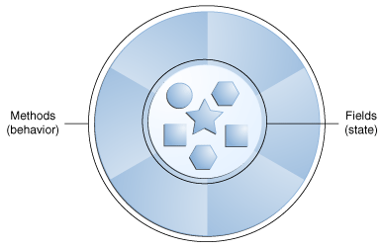
Object
Dogs have state
Name
Color
Breed
Hungry
Dogs have behavior
Barking
Fetching
Wagging tail

Slide 9
Object
Why objects? Software objects provide
Modularity: The source code for an object can be written and maintained independently of the source code for other objects. Once created, an object can be easily passed around inside the system.
Information-hiding: By interacting only with an object's methods, the details of its internal implementation remain hidden from the outside world.

Slide 10
Object
Code re-use: If an object already exists, you can use that object in your program. This allows specialists to implement/test/debug complex, task-specific objects, which you can then trust to run in your own code.
Pluggability and debugging ease: If a particular object turns out to be problematic, you can simply remove it from your application and plug in a different object as its replacement. This is analogous to fixing mechanical problems in the real world. If a bolt breaks, you replace it, not the entire machine.

Slide 11
Class
What Is a Class?
A class is the blueprint from which individual objects are created.
A class models the state and behavior of a real-world object.
In object-oriented terms that blueprint is an instance of the class of objects.
Example: Dog
public class Dog
{
// state using instance variables
// also know as member variables
String name;
boolean hungry;
// behavior using methods that can
// be called
public boolean isHungry()
{
return hungry;
}
public void setName(String name)
{
this.name = name;
}
}

Slide 12
Class
How do we know it’s a class?
Keyword class
Name starts with an uppercase letter
public class Dog
{
// state using instance variables
// also know as member variables
String name;
boolean hungry;
// behavior using methods that can
// be called
public boolean isHungry()
{
return hungry;
}
public void setName(String name)
{
this.name = name;
}
}

Slide 13
Class
I only know C, how does it correlate?
A class is like a struct, with it multiple variables
Instead of functions being outside of the struct, they would be inside the struct
Combine variables plus functions defined in a struct is a class in Java
#include<stdio.h>
#include<stdlib.h>
struct node
{
int data;
struct node *next;
}*head;
// Function prototypes
void append(int num);
void add( int num );
void addafter(int num, int loc);
void insert(int num);
int delete(int num);
void display(struct node *r);
int count();
// main function
int main()
{
}

Slide 14


Object
Encapsulation
Classes and the objects created from them encase their attributes and methods (i.e. state and behavior)
Objects can communicate with one another however how objects are implemented is not made public, in other words the details are hidden, hence information-hiding
Do you really care how an ATM works as long as it gives you money????

Slide 15
Object
What does “public” mean?
Public refers to what is called access level modifiers
Java has public, protected, private, and default
Anyone can access something is public
How are details hidden?
Use the private access level modifier
Only the class itself can access something that is private
More detailed discussion later!

Slide 16
Instantiation
What Is Instantiation?
Creating an object of the defined class
Dog puppy = new Dog();
Dog is the defined class
new is the keyword to create the object
Dog() is called a no-argument constructor which allocates the memory for the object
What is an Instance?
The created object is an instance of the class
puppy is an instance of class Dog
public class KeyTerminology {
public static void main(String[] args) {
// this is a declaration
Dog dog;
// this is instantiation
// it calls the constructor and
// allocates memory
Dog puppy = new Dog();
}
}
Declarations do not allocate memory therefore it is not an object or instance yet!
= new Dog() is just like the malloc() in C, memory is being allocated!

Slide 17
Inheritance
What Is Inheritance?
Creating a new class using an existing class
Inheritance provides a powerful and natural mechanism for organizing and structuring software.
Classes inherit state and behavior from their superclasses
public class Dog
{
private int age;
private String breed;
private String name;
private String activity;
private boolean hungry;
public boolean isHungry()
{
return hungry;
}
public void setName(String name)
{
this.name = name;
}
}

Slide 18
Inheritance
What Is Inheritance?
The new class is a subclass
Classes can be derived from another using the keyword extends followed by the superclass’s name
public class SubclassDog extends Dog{
/* inherited from superclass Dog
private int age;
private String breed;
private String name;
private String activity;
private boolean hungry;
*/
// extras unique to SubclassDog
private boolean swimmer;
private boolean barks;
private boolean searchAndRescue;
}

Slide 19
Inheritance
Different kinds of objects
often have a certain amount in common with each other.
yet each also defines additional features that make them different
Object-oriented programming allows classes to inherit commonly used state and behavior from other classes.

Slide 20
Inheritance
The subclass has all the same fields and methods as the superclass
Allows the subclass’s code to focus exclusively on the features that make it unique.
Makes code for subclasses easy to read.
Be sure to properly document the state and behavior that each superclass defines, since that code will not appear in the source file of each subclass.

Slide 21
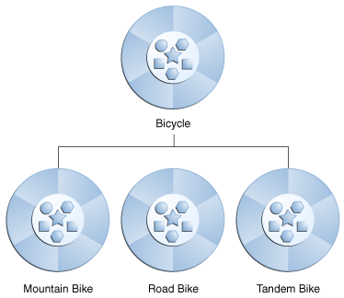
Inheritance
In Java
each class is allowed to have one direct superclass
each superclass has the potential for an unlimited number of subclasses

Slide 22
Interface
What Is an Interface?
Collection of related methods that tell objects what to do but now how to do it
They are just like function prototypes in C!
An interface is a contract between a class and the outside world.
#include<stdio.h>
#include<stdlib.h>
struct node
{
int data;
struct node *next;
}*head;
// Function prototypes
void append(int num);
void add( int num );
void addafter(int num, int loc);
void insert(int num);
int delete(int num);
void display(struct node *r);
int count();
// main function
int main()
{
}

Slide 23
Interface
public interface IDog
{
public void run();
public void fetch();
public void sleep();
public void eat();
}
When a class implements an interface, it promises to provide the behavior published by that interface
In its most common form, an interface is a group of related methods with empty bodies.
To implement this interface use the keyword implements in the class declaration.
public class DogTwo implements IDog
{
@Override
public void run() {}
@Override
public void fetch() {}
@Override
public void sleep() {}
@Override
public void eat() {}
}

Slide 24
Interface
Implementing an interface allows a class to become more formal about the behavior it promises to provide
If a class implements an interface, all methods defined by that interface must appear in its source code before the class will successfully compile
A class can implement zero or more interfaces

Slide 25
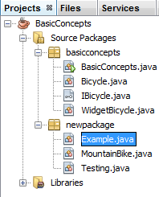
Package
What Is a Package?
A package is a namespace for organizing classes and interfaces in a logical manner.
Placing code into packages makes large software projects easier to manage.
The Application Programming Interface (API) provided by the Java platform has many packages.

Slide 26
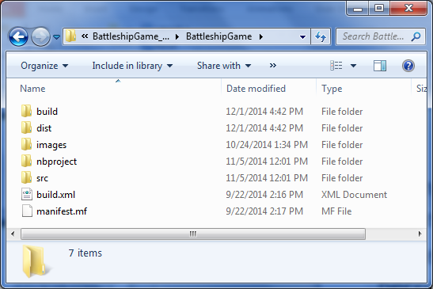
File system view
In Netbeans each project has a standard structure, the directories include:
build
dist
nbproject
src

Slide 27
File system view
build
Compiled Java source code files
File extension is .class
Class files are used during runtime
dist
An executable compressed version of the class files for distribution
Command to run is “java –jar BattleshipGame.jar”
Can also double-click the .jar file

Slide 28
File system view
nbproject
Netbeans specific files
Do not modify
src
Source code files
File extension is .java

